Slide 1
What are Biofuels?
Unit 1, Lesson 1

Slide 2
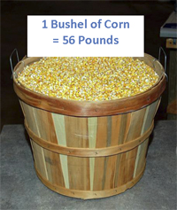
What is a bushel?
1 Bushel of Soybeans = 60 Pounds

Slide 3
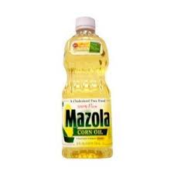
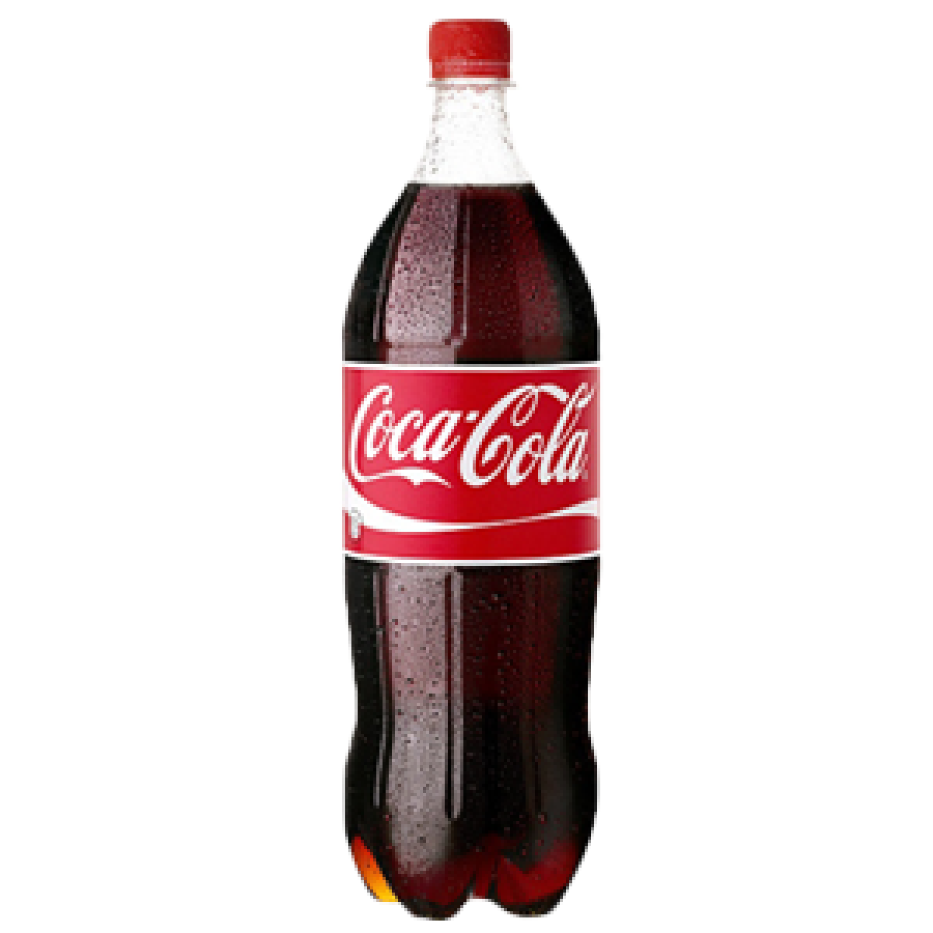
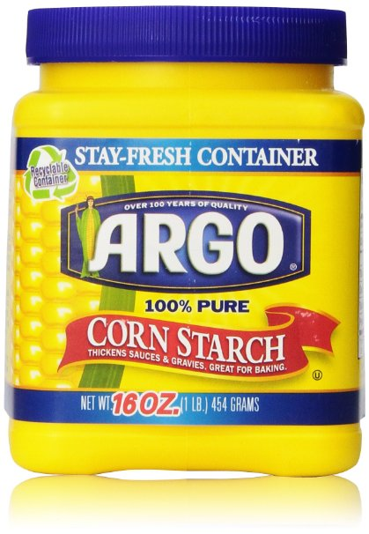
What can be made from a bushel of corn?
31.5 pounds of starch
33 pounds of sweetener
10 one-lb boxes of cereal
15 lbs of brewer grits (enough for 1 gallon of beer)
10 eight oz packages of cheese curls
1 lb of pancake mix
22 lbs of hominy feed for livestock
0.7 lbs of corn oil
17 lbs of carbon dioxide
1.5 lbs corn oil: cooking oil, margarine, mayonnaise, salad dressing, shortening, soups, printing ink, soap, and leather tanning
2.8 gallons of Ethanol

Slide 4
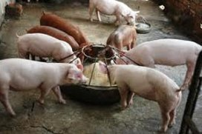
What can be made from a bushel of soybeans?
11 lbs crude soybean oil
Vegetable oil, creamers, margarine, mayonnaise, salad dressing, shortening, chocolate coating, cosmetics, pharmaceuticals, insecticides, paint
47 lbs soybean meal
Swine feed, poultry feed, beef cattle feed, pet foods, fish feed
39 lbs soy flour
Bread, candy, pancakes, pie crust, doughnut mix, frozen desserts
20 lbs soy protein concentrate
Baby foods, noodles, cereals, confections, candy, sausage casings, flavorings
12 lbs isolated soy protein
Adhesives, fungicides, printing inks, plastics

Slide 5
Ethanol or ethyl alcohol is in the alcohol family
Ethanol can be used as a fuel when blended with gasoline or when in its original state.
Ethanol is the most important member of a large group of organic compounds that are called alcohol.
Alcohol is an organic compound that has one or more hydroxyl (OH) groups attached to a carbon atom.
Alcohol is shown as: C-O-H or C-OH.
In its pure form, ethanol is a colorless clear liquid with a mild characteristic odor
Boils at 78C. (172F.)
Freezes at -112C. (-170F.).
The molecular weight is 46.07
One gallon of 190-proof ethanol weighs 6.8 pounds.
Ethanol has no basic or acidic properties.
Ethanol can also be used as a raw material in various industrial processes.
When burned ethanol produces a pale blue flame with no residue and considerable energy, making it an ideal fuel.
Ethanol mixes readily with water and with most organic solvents.
Ethanol is also useful as a solvent and as an ingredient when making many other substances including perfumes, paints, lacquer, and explosives.

Slide 6
Biodiesel Compared to Petroleum Diesel
Made of fatty acid methyl ester produced by transesterification of triglycerides from vegetable oil
Each molecule is 17 hydrocarbons with one ester group
Domestically produced from non-petroleum, renewable resources
Can be used in most diesel engines, especially newer ones
Less air pollutants (other than nitrogen oxides)
Less greenhouse gas emissions (e.g., B20 reduces CO₂ by 15%)
Biodegradable
Non-toxic
Safer to handle
Petroleum diesel is made from crude oil extracted from the earth.
Each molecule is 16 hydrocarbons
Use of blends above B5 not yet approved by many auto makers
Lower fuel economy and power (10% lower for B100, 2% for B20)
Currently more expensive
B100 less ideal for use in low temperatures
Slight increase in nitrogen oxide emissions possible in some circumstances

Slide 7
Why biofuels now?
Biofuel use and production has increased considerably starting in the 1980's. Growth in use of the E-10 ethanol blend has taken place because the fuel performs well in automotive engines and is competitively priced with "conventional" gasoline.
Each bushel of corn processed yields 2½ gallons of ethanol and several valuable byproducts.
Each bushel of soybeans yields 1.4 gallons of biodiesel and byproducts.
It is in our state and national interest to reduce dependence on oil imports.
Trade deficits are decreased and it allows for a dependable source of fuel if supplies would be cut off by unfriendly countries.
It helps to stabilize price for the American farmer.
The quality of the environment improves. Carbon monoxide emissions are reduced and lead and other carcinogens (cancer causing agents) have been removed from gasoline.
Car owners gain from increased octane in gasoline which reduces engine knock. It also absorbs moisture and cleans the fuel system.

